Slide 1
CIDC on the Hill/Compendium Information
2024

Slide 2
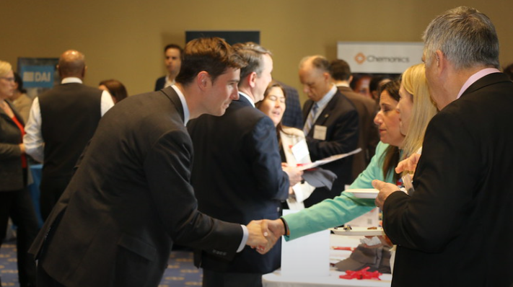
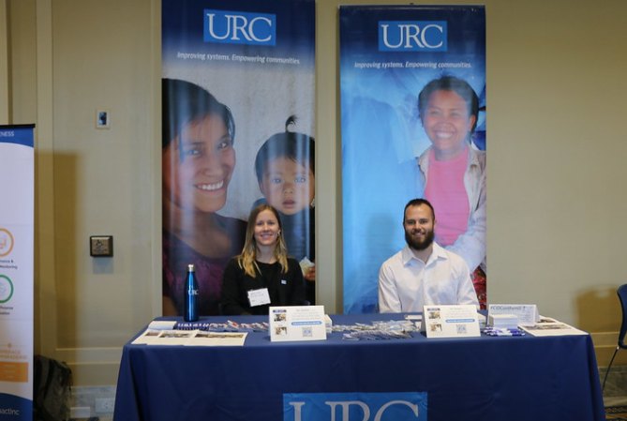
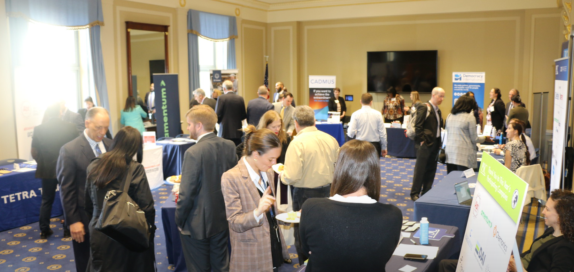
CIDC on the Hill
April 17, 2024 | Rayburn Building
Table to promote your company
Printed Compendiums to spotlight success
20 postcards w/QR code to digital Compendium

Slide 3
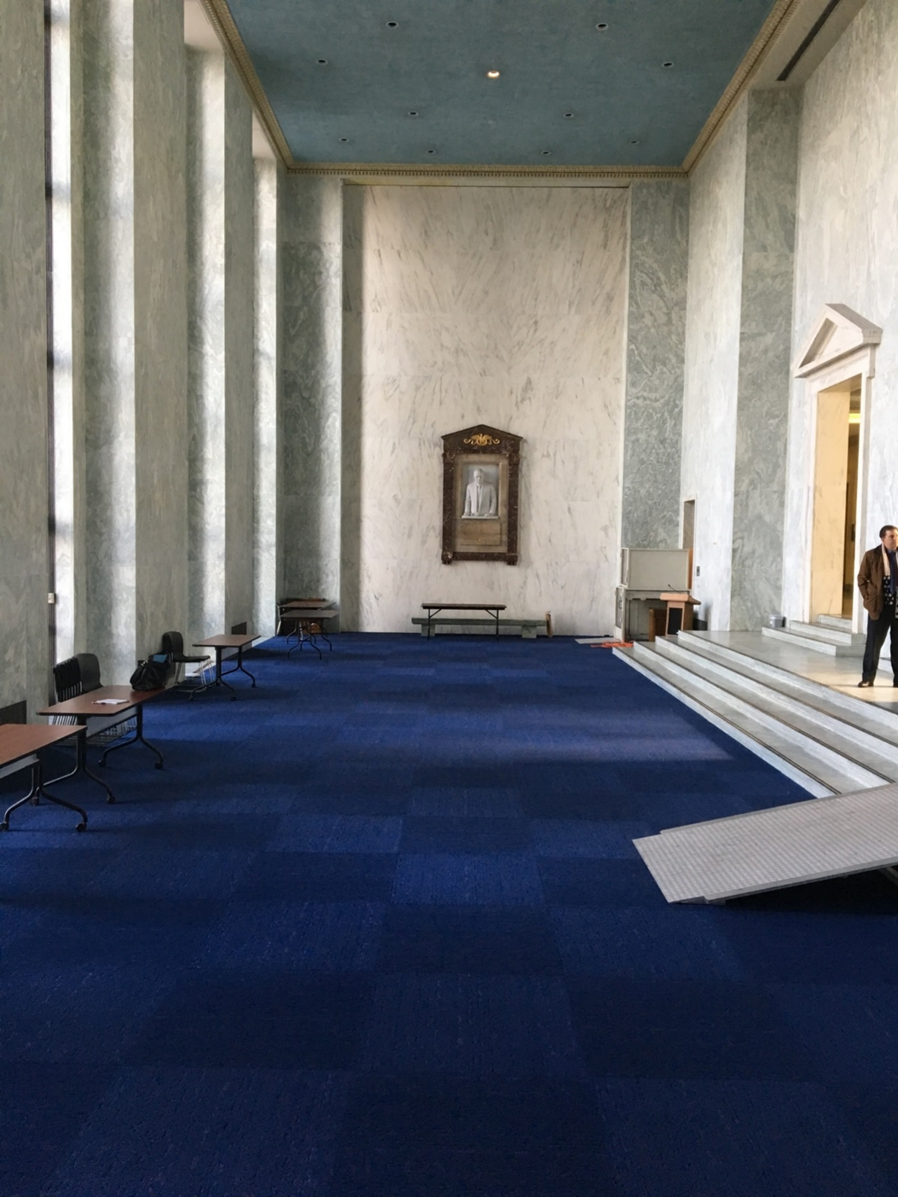
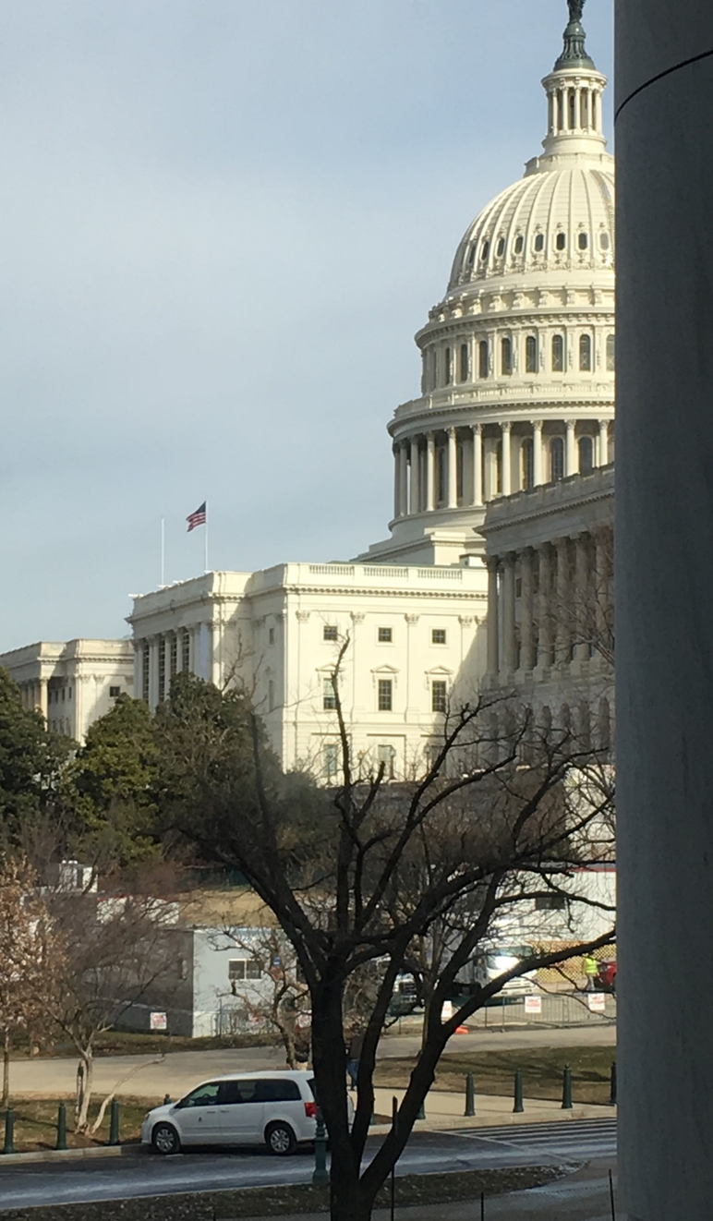
CIDC on the Hill Room Layout

Slide 4
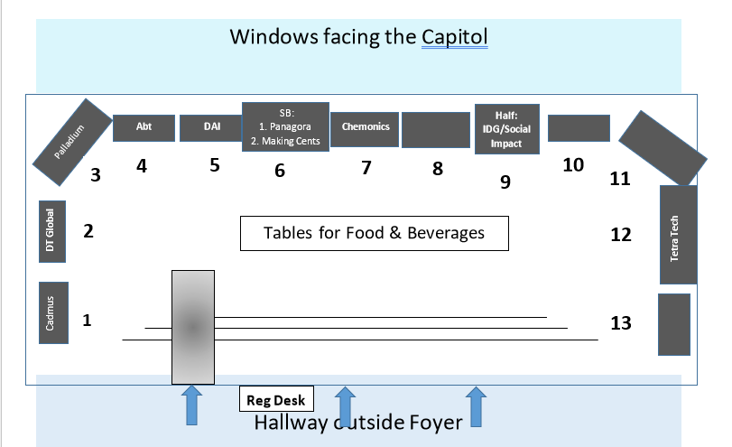
CIDC on the Hill Room Layout

Slide 5
CIDC Compendium
American Development Companies: Addressing the Needs of a World in Crisis
One-Page (~450 words)
Branded project, recently completed project, etc.
Submissions
Word doc of article
Photos to be included
High-res logo
Social media handles
POC of comms
Submit here:
www.pscouncil.org/CIDContheHill2024

Slide 6
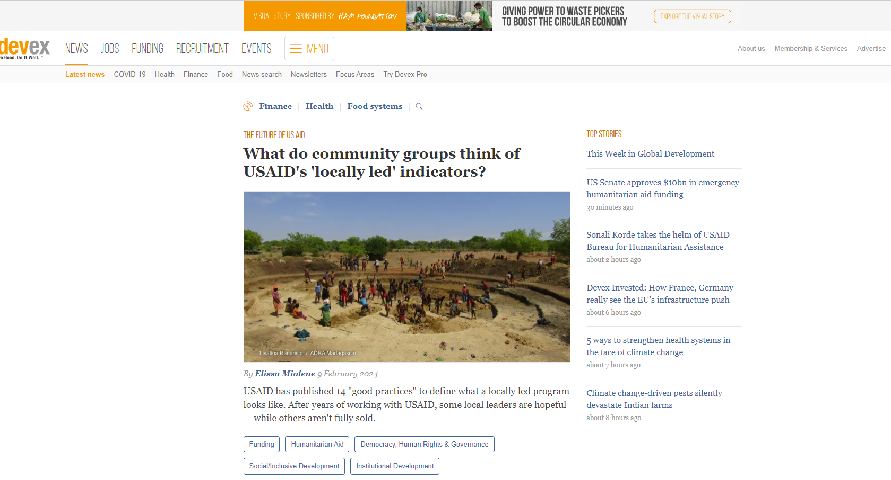
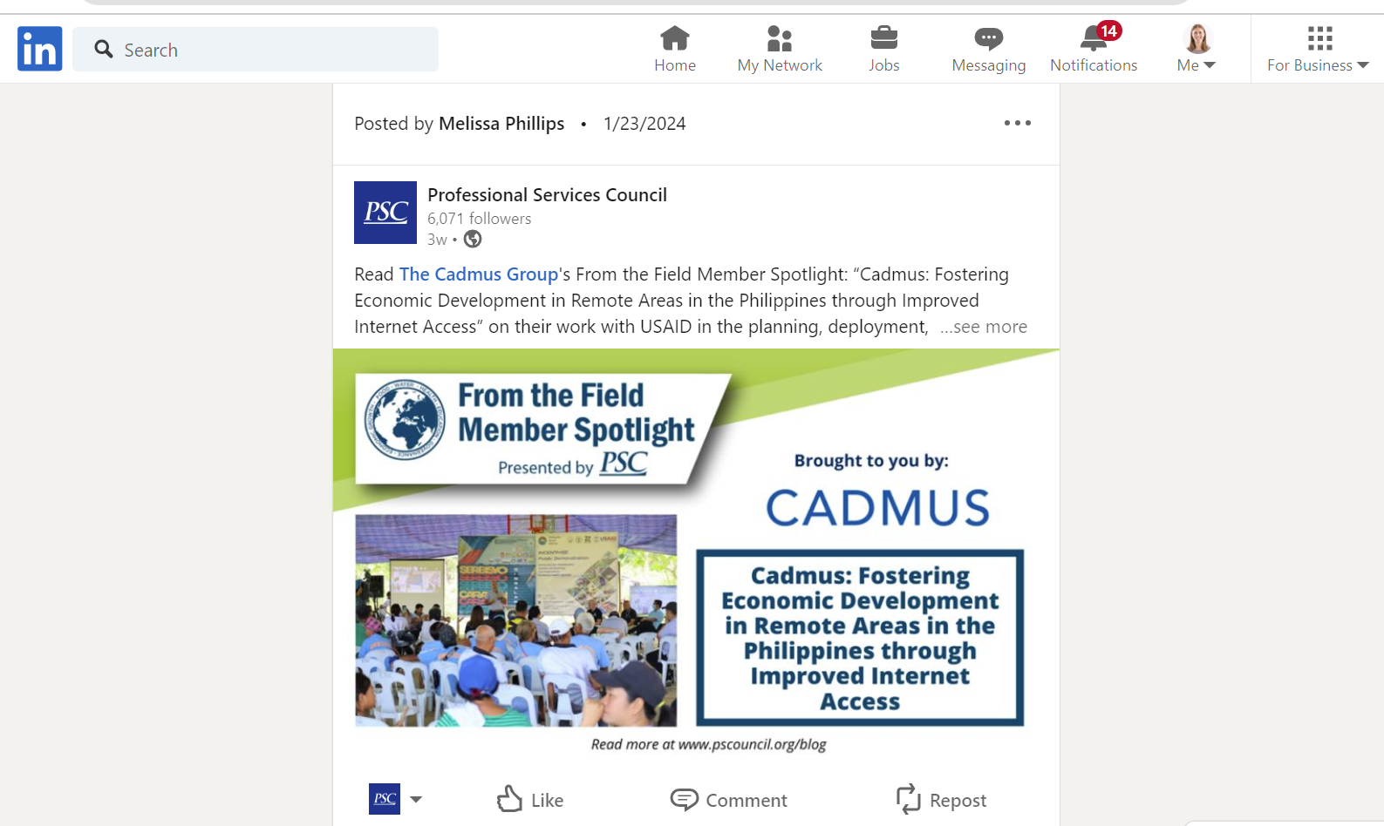
CIDC on the Hill/Compendium - Marketing
Logo in invitation to Congressional members
Printed Compendium at event
Digital Compendium on PSC website
Company-specific social media posts on all PSC platforms
Compendium ads in Devex – inline block ad on news pages week of April 15, 2024 and the first week of U.N. General Assembly in September

Slide 7
Geo-Fencing Ads
100% mobile app ads via 150k+ premium apps (CNN, ESPN, Weather Channel)

Slide 8
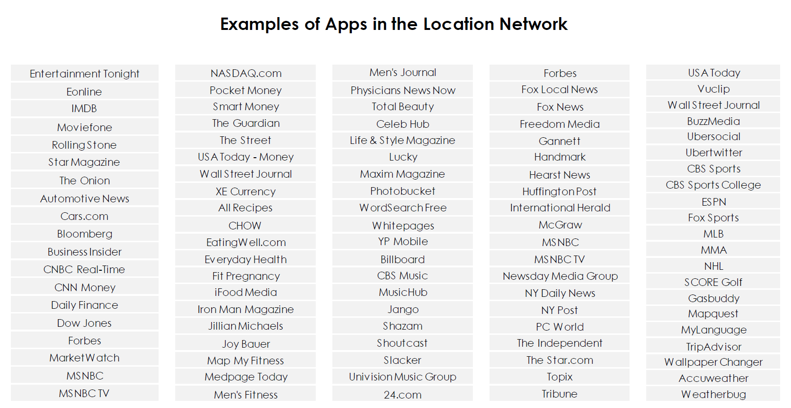

Slide 9
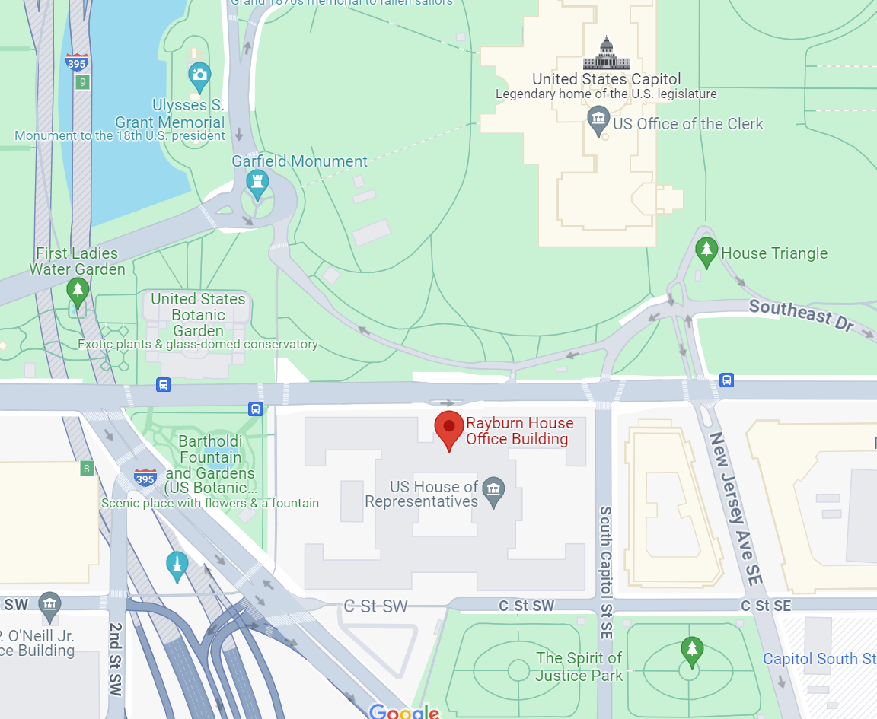
CIDC on the Hill/Compendium – Marketing
Geotargeting Ads
Location-Based
When consumers are within the designated location radius, they are served an ad on their mobile device. The ads appear on a network of apps. Consumers who have the location service turned on for those apps and within the location radius will see the ad. i.e. if someone is ordering a ride-share or visiting a news app they may see the ad.
The Rayburn and adjacent Longworth Buildings house the offices of more than 300 Representatives and dozens of key Congressional Hearing rooms, ensuring many thousands of views over the week.
Due to the nature of location-based ad services, they provide highly-relevant info to the consumer.
When clicking the ad for more information, users are directed to a customized landing page with recommended actions.

Slide 10
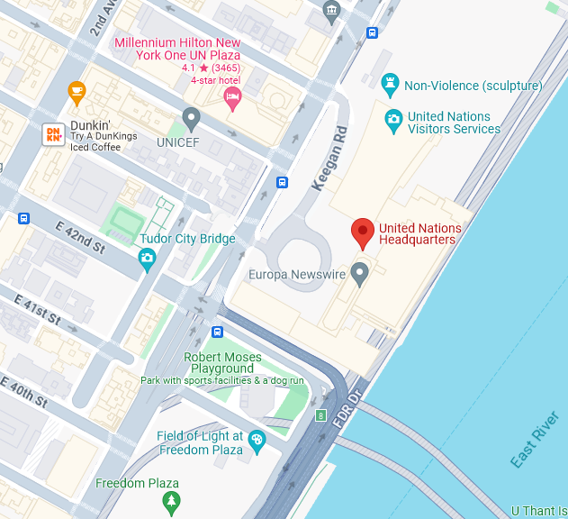
UN General Assembly - Marketing
CIDC Compendium Spotlight
Ad in Devex – site header banner week in Sept.
Geotargeting ads week in Sept.

Slide 11
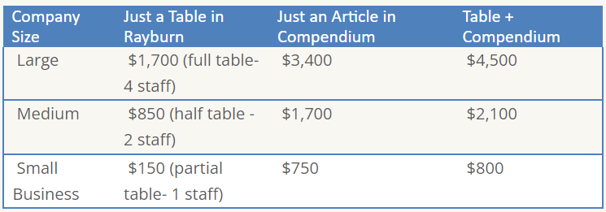
CIDC on the Hill & Compendium Pricing
**Submit your order here
https://www.pscouncil.org/Shared_Content/Events/Event_Display_with_Program_Items.aspx?EventKey=2024HILL

Slide 12
Thank you!
CIDC contact: Paul Foldi foldi@pscouncil.org
Marketing contacts: Cassie Katz & Anna Nestler marketing@pscouncil.org
Sponsorship & advertising contact: Cole Model sponsorship@pscouncil.org
Event contacts: Jean Tarascio & Marin Selig events@pscouncil.org

